Slide 1
Results

Slide 2
Big Picture
Machine Learning – includes human automated analyses (think thermal image detector)
Also includes analysis of tabular data
Equivalent to nonparametric statistical approaches
Trade off: statistical vs machine learning approach
Model interpretability vs predictive power
Which model will generalize to new data well?

Slide 3
Methods
Identical dataset to the PHKC report
Used same test/training datasets
Grid search on 7 different types of ML classifiers to find best parameters
Very automated – JAL had a different intention

Slide 4
Results
Random forest can improve on the statistical model used
Highest improvement is LANO (SHBA + BBBA)
P(Curtail | Bats) = 0.77 0.79
P(No bats | Curtail) = 0.53 0.35
Modest improvements
All bats
P(Curtail | Bats) = 0.72 0.78
P(No bats | Curtail) = 0.28 0.18

Slide 5
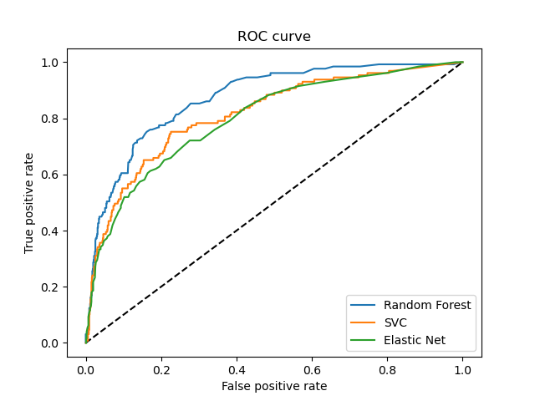
All

Slide 6
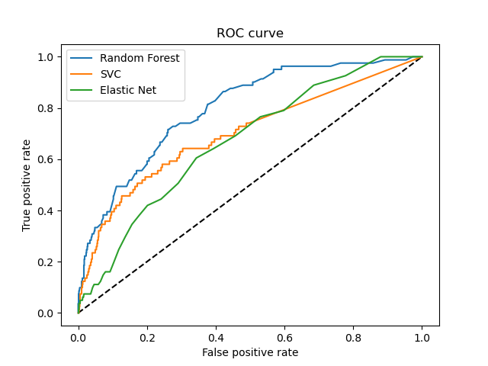
LANO

Slide 7
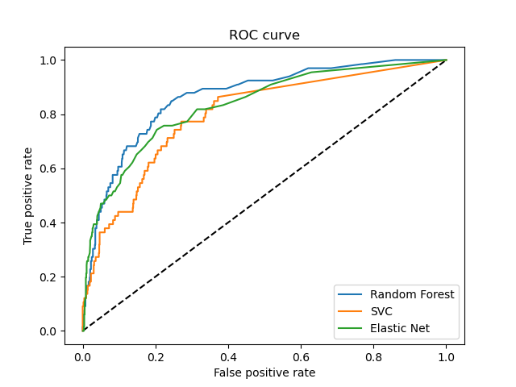
LABO

Slide 8
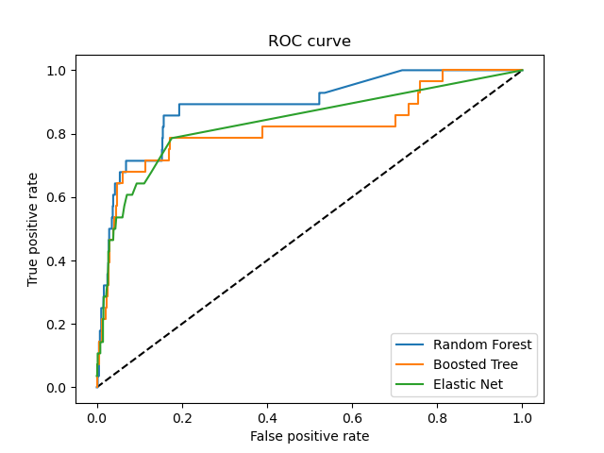
LACI

Slide 9
Next steps
Should we try more types of ML models?
Is this improvement worth noting? Does it really change any conclusion from the PH KC paper?
Are clients interested in model interpretability?

